Slide 1
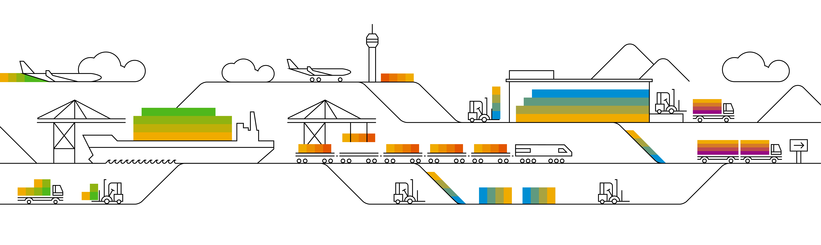
Concept for XSUAA bindings

Slide 2
Prototype SCP Authentication + Authorization for UI
Infrastructure Tenant/Subaccount
DWC Tenants/Subaccounts
XSUAA
Retrieve JWT
Service Binding
Service Binding
Browser
revenue.cloud.sap
Jupiter
Landscape
Router
Microservice
JWT
Basic Auth
Endpoint protection based on scopes

Slide 3
Concept SCP Authentication + Authorization for API
Customer Tenant/Subaccount
Infrastructure Tenant/Subaccount
DWC Tenants/Subaccounts
Jupiter
(Reuse Service Instance)
Clone XSUAA (Plan broker)
Jupiter Service Broker
Master XSUAA (Plan broker)
Retrieve Client
Credentials
Retrieve JWT
Service Binding
Service Binding
Consumer
Jupiter
(revenue.cloud.sap/api)
Landscape
Router
Microservice
JWT
JWT
Basic Auth
Verify JWT with public key
Endpoint protection based on scopes

Slide 4
Feature Parity with YaaS
infrastructure space
Jupiter
landscape-router
XSUAA
service plan: broker
XSUAA
service plan: application
XS-Security json mit API scopes
XS-Security json mit UI scopes
Notes:
Nur calls durchlassen für production mit scopes die released. Die scopes an ein Feature hängne bzw. welche scopes sind für eine stage verfügbar.
Problem: Re-Use von scopes für neue Endpunkte schwierig bzw. nicht möglich. Wird ein neuer scope eingeführt dann muss ein Toggle verwendet werden. Aber wenn eine neue Route mit neuem scope eingeführt kann gesagt werden, dass eine Route mit einem scope released wird.

Slide 5
Complex Case
infrastructure space
DevTest/AllFeatures stage
product-config
31 Services json‘s
DevTest/AllFeatures -XSUAA: broker
landscape-router
DevTest/AllFeatures -XSUAA: application
PrepareRELPatch/Test stage
PrepareRELPatch/Test -XSUAA: broker
PrepareRELPatch/Test -XSUAA: application
product-config
31 Services json‘s
RELprod -XSUAA: broker
RELprod -XSUAA: application
RELprod stage
product-config
31 Services json‘s
N (> 10) -XSUAA: broker
Jupiter
N (> 10) -XSUAA: application
N (> 10) stages
product-config
31 Services json‘s
> 20 XSUAA instances
> 310 single Services JSON

Slide 6
Landscape Approach
infrastructure space
Test Landscape
product-config
31 Services json‘s
Test Landscape
-XSUAA: broker
landscape-router
Test Landscape
-XSUAA: application
Candidate Landscape?????
Candidate Landscape -XSUAA: broker
Candidate Landscape -XSUAA: application
product-config
31 Services json‘s
Prod -XSUAA: broker
Prod -XSUAA: application
Prod
product-config
31 Services json‘s
Beta -XSUAA: broker
Jupiter
Beta -XSUAA: application
Beta
product-config
31 Services json‘s
2 x n-landscapes XSUAA instances
n-landscapes x 31 single Services JSON

Slide 7
Conclusion
Approach 1 (Feature Parity) for now
Points for discussion (proposed by Markus):
Introduce a flag „released“ for scopes
Scopes which have not been released will still be seen by customers on SCP and can be assigned to users, but the landscape router will not let requests through which contain a not released scope (in production)
Problem:
For new endpoints which will be protected with existing scopes, the endpoint still needs to be toggled off. Only for endpoints which will be protected by new scopes, this approach can be used.
Additional implementation effort for BP team in landscape-router (landscape-router does not know in which stages only „released“ scopes are allowed)

Slide 8
Outbound communication Option “Central Registry, per App Destination Service Binding”
Infrastructure
Tenant/Subaccount
Customer SaaS Account
XSUAA
Retrieve JWT
Ngom Registry
(DwC aware)
Destination
Service
Retrieve JWT
Service Binding
Service Binding
Service Binding
Service Binding
1. Fetch JWT
2. Fetch URL + Credentials
DWC Tenants/Subaccounts
External PaaS Account
Browser
revenue.cloud.sap
Jupiter
Landscape
Router
Microservice
Payment
Service
Basic Auth
Correlation ID
Lib+Rest Template
JWT
3. Http Request
Endpoint protection based on scopes

Slide 9
Outbound communication Option “Central Registry, Central Destination Service Binding”
Infrastructure
Tenant/Subaccount
Customer SaaS Account
XSUAA
Retrieve JWT
Ngom Registry
(DwC aware)
Destination
Service
Retrieve JWT
Service Binding
Service Binding
1b. Fetch URL + Credentials
Service Binding
Service Binding
1a. Fetch URL + Credentials
DWC Tenants/Subaccounts
External PaaS Account
Browser
revenue.cloud.sap
Jupiter
Landscape
Router
Microservice
Payment
Service
Basic Auth
Correlation ID
Lib+Rest Template
JWT
3. Http Request
Endpoint protection based on scopes

Slide 10
Outbound communication Option “Proxy”
Infrastructure
Tenant/Subaccount
Customer SaaS Account
XSUAA
Retrieve JWT
Outbound Proxy (DwC aware)
Destination
Service
Retrieve JWT
Service Binding
Service Binding
1b. Fetch URL + Credentials
Mapping or convention?
Routes=> Destinations
Service Binding
Service Binding
1a. Http Request
1c. Http Request
DWC Tenants/Subaccounts
External PaaS Account
Browser
revenue.cloud.sap
Jupiter
Landscape
Router
Microservice
Payment
Service
Basic Auth
Correlation ID
Lib+Rest Template
JWT
Endpoint protection based on scopes

Slide 11
Outbound communication Option “decentralized, lib only”
DWC (PaaS) Tenants/Subaccounts
Customer SaaS Account
XSUAA
XSUAA
Tenant-Specific Data
Retrieve JWT
Service Binding
Service Binding
1. Retrieve JWT
Browser
revenue.cloud.sap
Jupiter
Landscape
Router
Microservice
Basic Auth
Subdomain
Lib+Rest Template
JWT
Service Binding
2. Call Re-Use Service
Re-Use
Service Instance
Endpoint protection based on scopes
Infrastructure
Tenant/Subaccount

Slide 12
Outbound communication Option “decentralized, lib only”. Special case “Destination Service”
Customer SaaS Account
XSUAA
XSUAA
Destination
Retrieve JWT
Service Binding
Service Binding
1. Retrieve JWT
3. Http Request
DWC (PaaS) Tenants/Subaccounts
Browser
revenue.cloud.sap
Jupiter
Landscape
Router
Microservice
Payment
Service
Basic Auth
Subdomain
Lib+Rest Template
JWT
Service Binding
2. Fetch Destination
Destination
Service Instance
Endpoint protection based on scopes
Infrastructure
Tenant/Subaccount

Slide 13
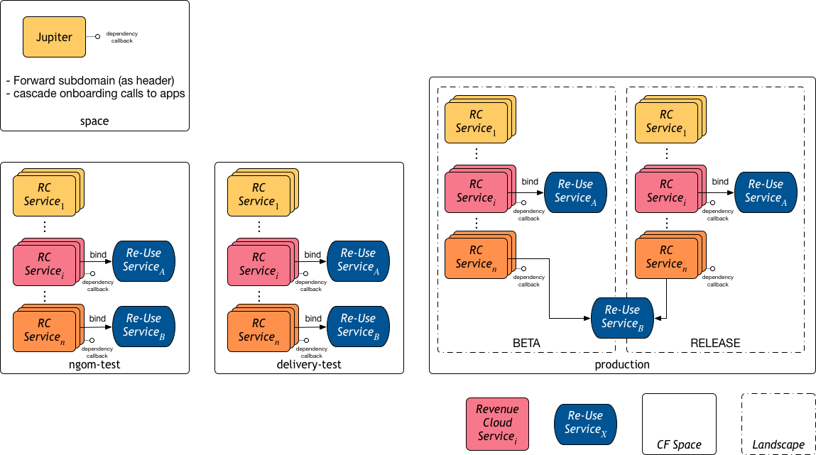
Outbound communication, Option “decentralized, lib only”, DwC Details

